Slide 1
Predicting Housing Prices in Ames, Iowa
Brandon Spiegel
June 28, 2019

Slide 2
Agenda:
Data Organization
Data Visualization and Analysis Strategy
Example Feature Engineering
Model Building
Residuals Analysis and Next Steps

Slide 3
Data Organization (1 of 2)
81 features of data in the Ames Iowa dataset were categorized into one of 10 groups in order to compare similar features and improve feature engineering
81 Features
Key Quality Measures | Indoor SF and Space Quality | Garage Features | Construction Years | Indoor Rooms and Quality
Indoor Features and Utilities | Building Type and Construction | Outdoor Features | Lot Characteristics | Sales Characteristics and Neighborhood

Slide 4
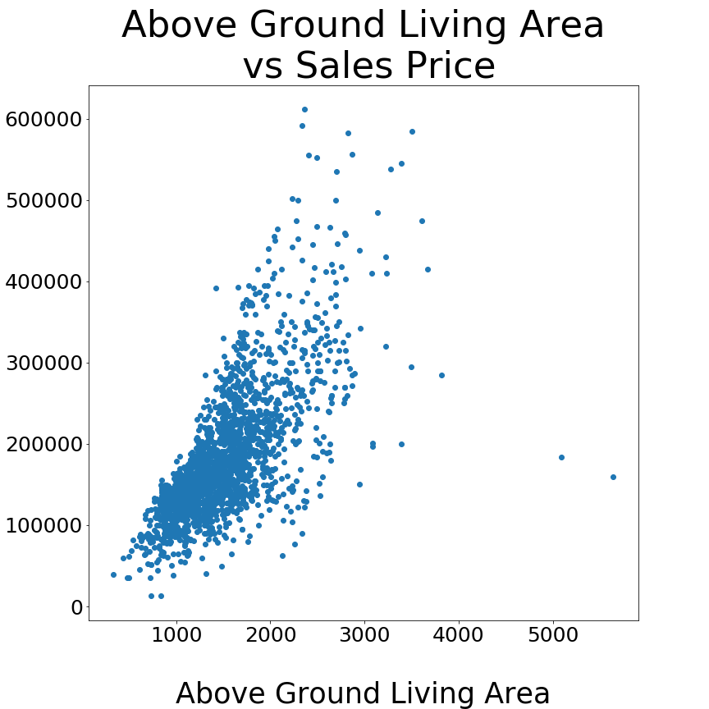
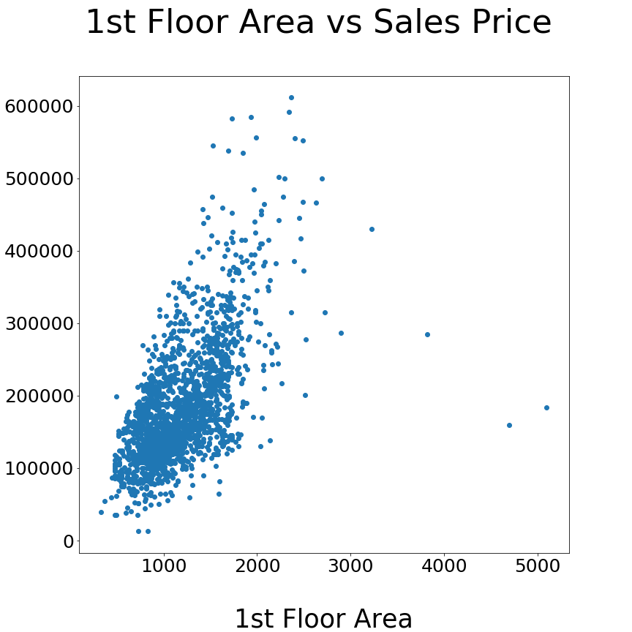
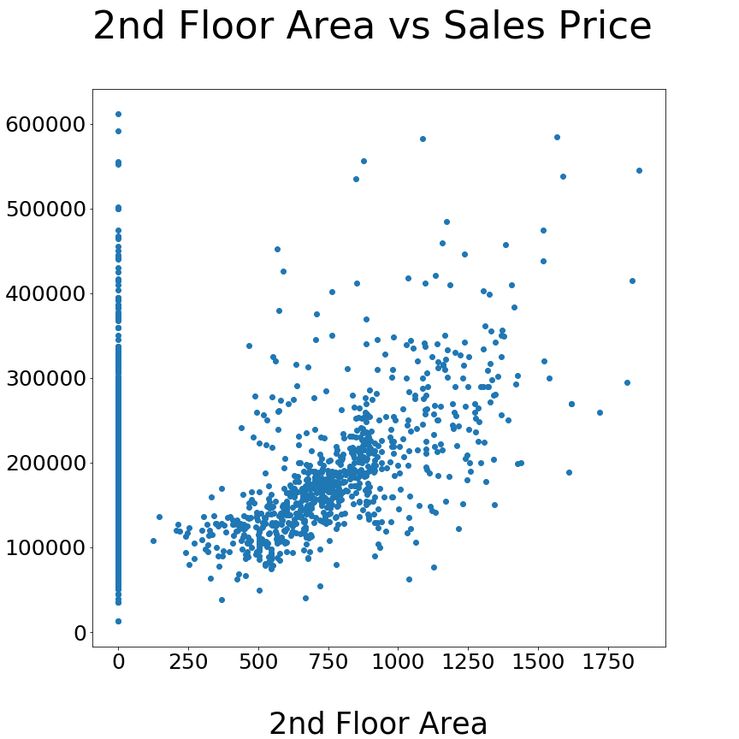
Data Organization (2 of 2)
Grouping features into categories allows for easy comparison of related features such as various SF measurements
.
Indoor SF and Space Quality

Slide 5
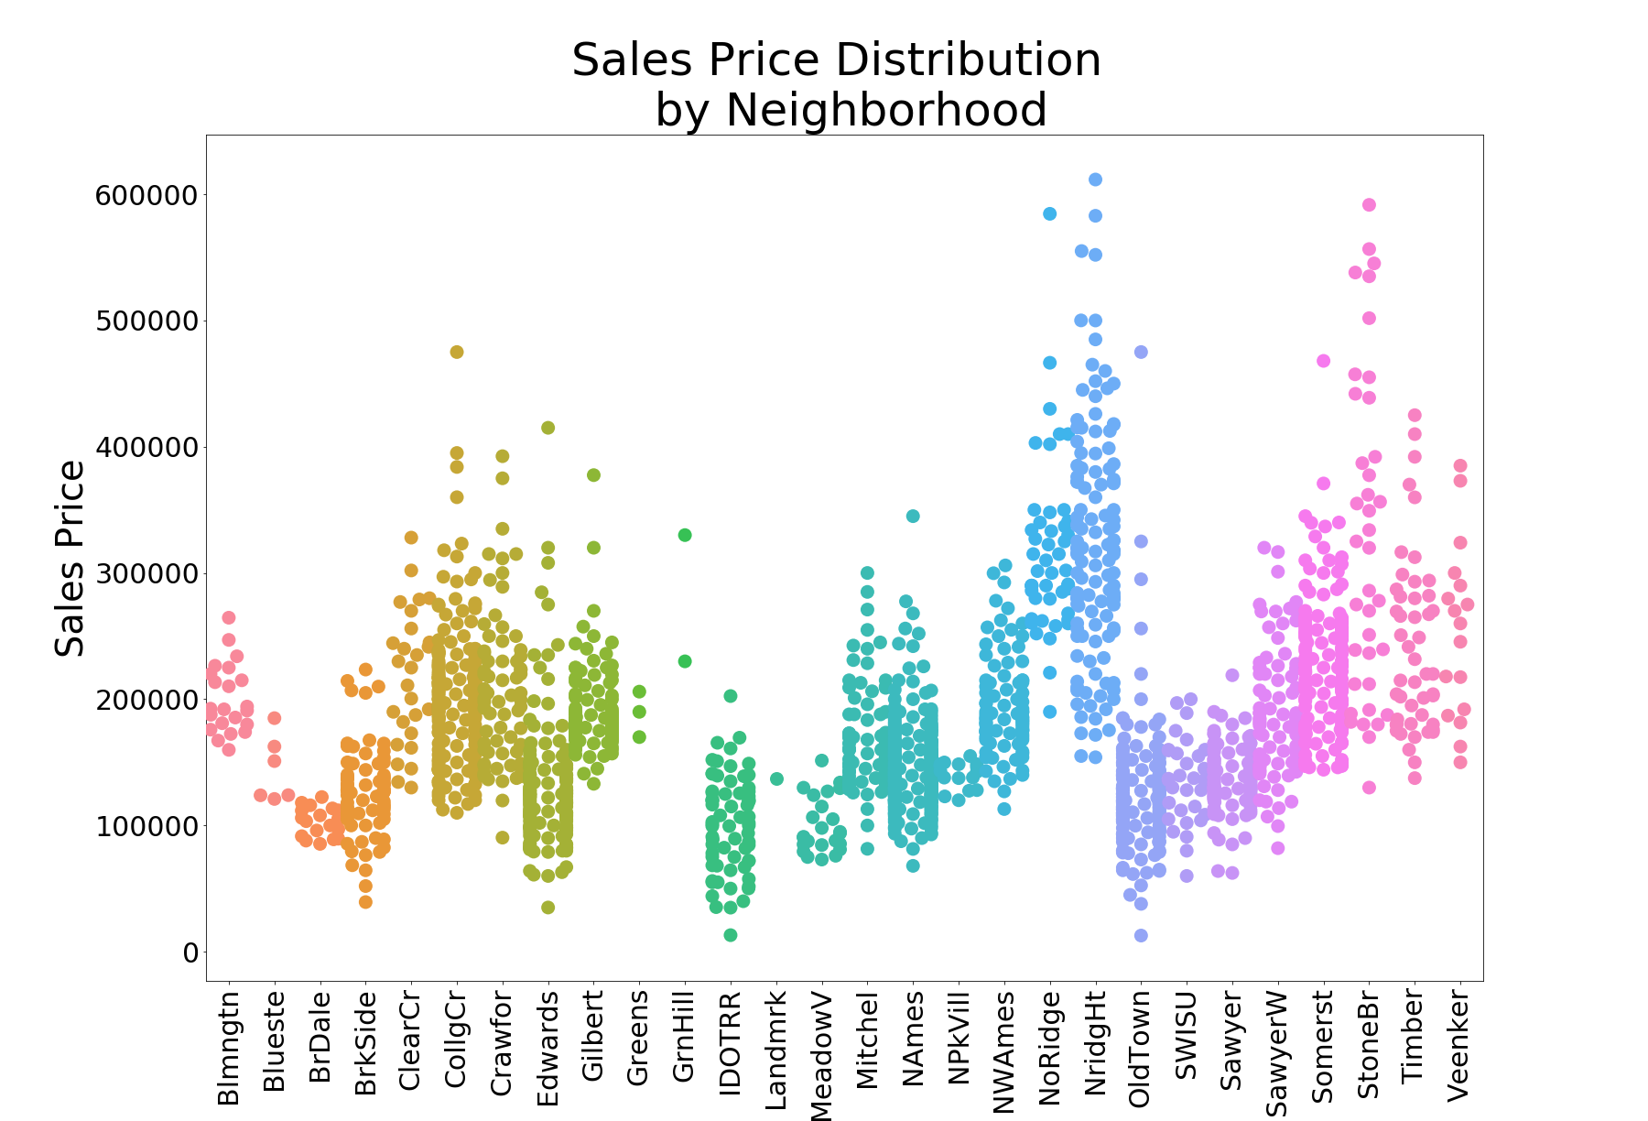
Data Visualization
Swarmplots enable visualization of density and distribution of data across and within categorical variable categories.

Slide 6
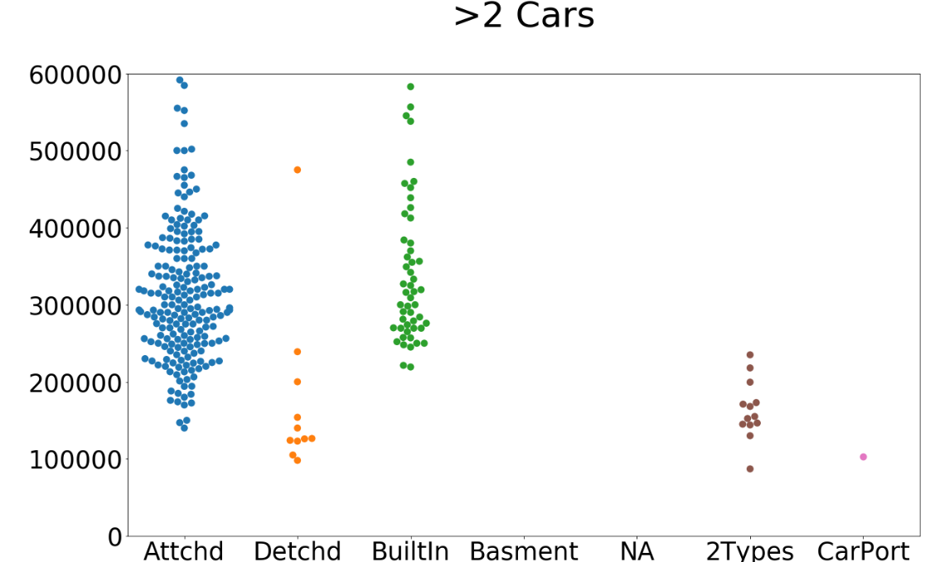
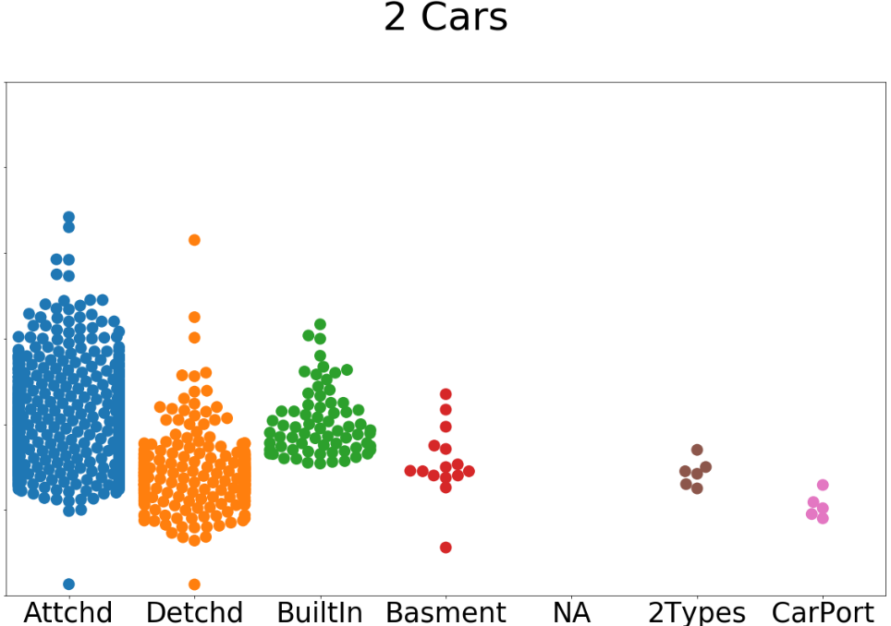
Feature Engineering
Combining garage features into an interaction term allowed for refined segmentation of prices.
Sales Price By Garage Type and Capacity

Slide 7
Model Building
Model features were added incrementally to ensure that’s both R² and RMSE increased significantly each time.
R² | RMSE | 1st Flr, 2nd Flr, and Bsmt SF | Overall Quality | Number of Bathrooms | Interacted Garage Features | Kitchen Count and Quality | Neighborhood | Other Features
0.6 | 53,000 | ✓
0.78 | 36,000 | ✓ | ✓
0.81 | 33,900 | ✓ | ✓ | ✓
0.83 | 32,100 | ✓ | ✓ | ✓ | ✓
0.84 | 30,900 | ✓ | ✓ | ✓ | ✓ | ✓
0.875 | 26,500 | ✓ | ✓ | ✓ | ✓ | ✓ | ✓
0.88 | 25,300 | ✓ | ✓ | ✓ | ✓ | ✓ | ✓ | ✓

Slide 8
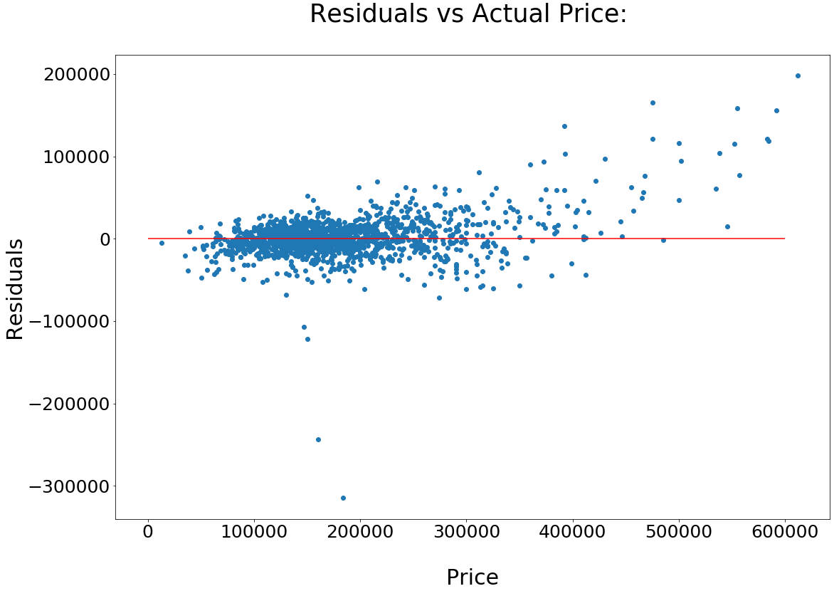
Residuals Analysis and Next Steps
Residuals at lower prices are relatively small and centered at 0, while at higher actual prices, residuals are larger and entirely positive.
Next Steps
Focus on improving predictions for homes >$350,000
Potential option: Interaction terms among features limited to higher priced homes

